Slide 1
Minoring in LDT
http://bit.ly/LDTMinorSlides

Slide 2
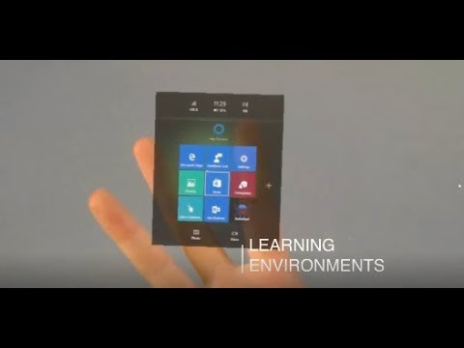
What is LDT?

Slide 3
LDT...
Dates back to 1972
Was formerly Educational Technology in the College of Education
Is now part of the School of Journalism and Media Studies
Primarily a Masters program with over 800 alumni
Can be thought of as an engineering or architectural approach to learning problems
Not just about Technology. It’s equally about Learning and Design as well.

Slide 4
All Online but with Live Zoom Meetings

Slide 5
The LDT Minor
LDT 540 - Educational Technology
LDT 544 - Instructional Design
LDT 515 - Games, Play and Learning
LDT 525 - Mixed Reality, Virtual Worlds and Future Learning
LDT 561 - Advanced Multimedia Design for Learning

Slide 6
Course Schedule
FALL
LDT 540 - Educational Technology
LDT 515 - Games, Play and Learning---also offered in the Spring
LDT 561 - Advanced Multimedia for Learning
SPRING
LDT 525 - Mixed Reality, Virtual Worlds and Future Learning
LDT 544 - Instructional Design
Enroll in LDT 596 (Consciousness hacking) if you can’t add any of the above courses due to schedule conflict. 596 is asynchronous and offered in both semesters.

Slide 7
LDT 540: Educational Technology
Overview
This course provides an introduction to the field of Educational Technology and Instructional Design. It provides practice at analyzing situations in which there is a need for improved performance and gathering data to design a solution.
Recent examples of student topics:
Social workers are late turning in their weekly case notes
Faculty need to create accessible documents for their courses
Substitute teachers are making too many errors during safety drills
Students in the Maker Lab are wasting the 3D printing filament
Roommates consistently leave the apartment a mess

Slide 8
LDT 540: Educational Technology
Projects
Performance Analysis: Analyze a real performance problem chosen from the student’s work or personal life
Examine data or gather new data through interviews, observations, or simple surveys
Write a report with recommendations about how to solve the problem, detailing a solution system that may include training and information support, plus non-training interventions (e.g., proper incentives, improved tools or supervisor support, etc.)
Job Aid: Design a visual guide to address the performance problem identified during the analysis
Design a prototype, test with real audience members or classmates, refine the design
Write a report detailing the design rationale, prototype methods and findings, and recommendations for implementation

Slide 9
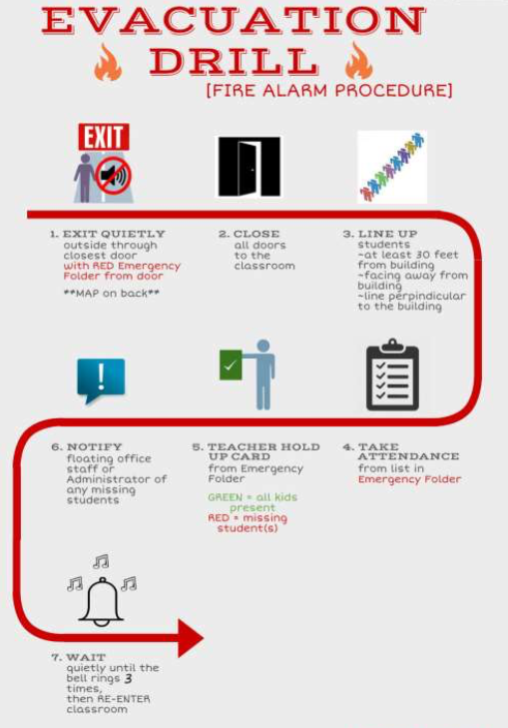
LDT 540
Example Job Aid

Slide 10
LDT 540: Educational Technology
Application to Other Majors
Use systems thinking to explore how various individual and organizational factors influence human behavior in the workplace
Use a systematic and iterative design approach to develop solutions that are data-driven and user-centered
Gather and make sense of qualitative and quantitative data
Employ proven design principles for the effective use of text, visuals, and layout to create learning and information resources for online and print
Write professional-style, concise reports

Slide 11
LDT 544: Instructional Design
Overview
Systematic design of products for education and training.
Use of cognitive task analysis to determine instructional content.
Development of instructional goals and product specifications.
Rapid prototyping of instructional products.

Slide 12
LDT 544: Instructional Design
Projects:
Girl Scouts Volunteer Training
The Learning Choice Academy
Virtual reality with CoSpaces
Financial Independence Training (FIT)

Slide 13
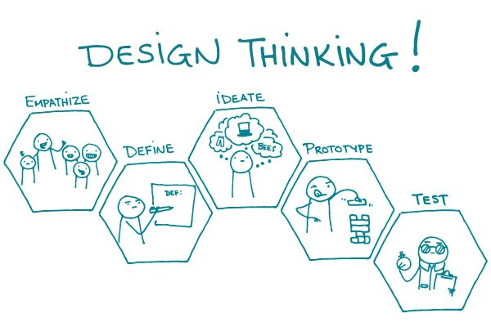
LDT 544: Instructional Design
Application to Other Majors
Instructional design skills
Design thinking
Prototype development using tech tools
Evaluation and assessment

Slide 14
LDT 515: Games, Play & Learning
Overview
Games, Play and Learning is designed to deepen your understanding of the natural human activities of play and learning. Throughout the course we will revisit questions like these:
• What makes a game fun?
• How can games be used to teach?
• How do you design a game?

Slide 15
LDT 515: Games, Play & Learning
Projects
Analyze your own game preferences in terms of personality
Redesign Pokemon Go as a way to teach something
Create an educational card game
Modify a computer game
Analyze serious games that cover topics like poverty, the environment and health and outline a new serious game on another topic
Analyze Fortnite from the point of view of violence in games
Participate in a role play about adopting game-based learning

Slide 16
LDT 515: Games, Play & Learning
Application to Other Majors
Insight into motivation and interest
Ideas for training others in a fun way
Experience with a powerful integrated development platform
Analytical skills applied to a complex human enterprise

Slide 17
LDT 525: Mixed Reality, Virtual Worlds
Overview
Someday soon, you’ll pull a visor over your eyes and forget where you are. You’ll use this headset to play games, explore other parts of the world, hobnob with friends, and learn new skills. While covering your eyes and ears, you’ll open yourself up to worlds that could barely be imagined by your parents. Virtual reality, augmented reality, and virtual worlds are moving from the labs and geeks to the mainstream. How will this change entertainment, news, and education?

Slide 18
LDT 525: Mixed Reality, Virtual Worlds
Projects
Create a linked set of 360º photos to teach about a specific place
Analyze existing VR experiences and design one to teach other content
Analyze existing AR and MR experiences and lay out the design of a new one
Visit an virtual world (e.g., Second Life, AltSpace VR, Sinespace) and observe interpersonal interactions.
Design an interactive learning experience in a virtual world using Amazon Sumerian.

Slide 19
LDT 525: Mixed Reality, Virtual Worlds
Application to Other Majors
Experience with media that will be commonly used in business, education, and home entertainment
Familiarity with technologies currently available and insight into developments likely over the next five years
Analytical skills
Critical evaluation of new technologies

Slide 20
LDT 561: Advanced Multimedia Design
Overview
Create appealing visuals (still images)
Create short videos and animations from storyboarding to scripting to production
Learn and apply visual design principles and instructional design strategies.

Slide 21
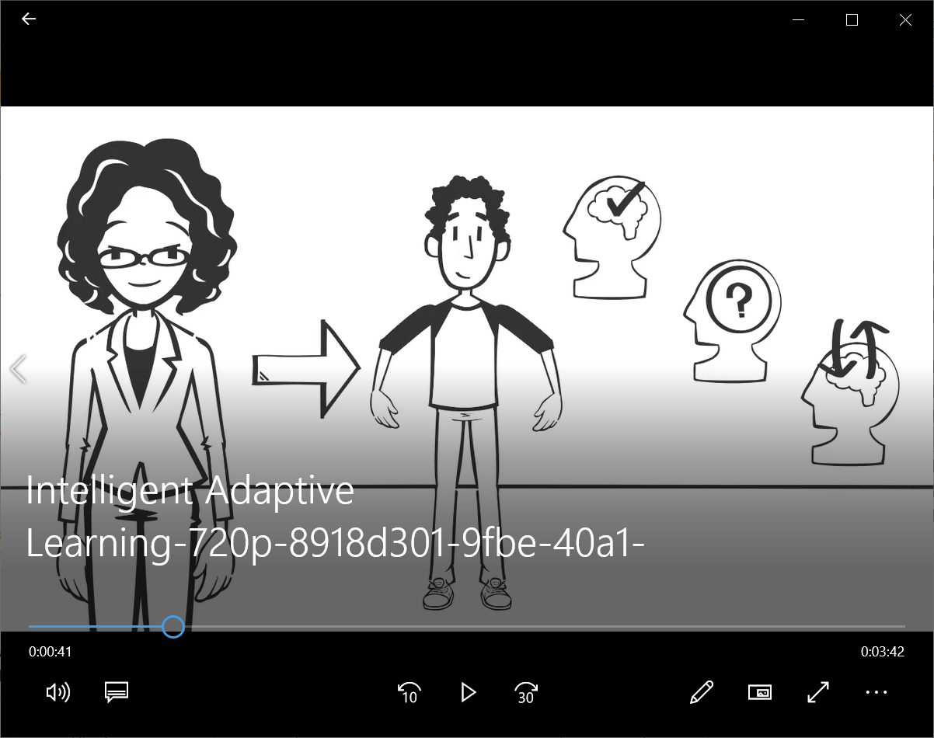
LDT 561
Projects
Notes:
Example of a storyboard

Slide 22
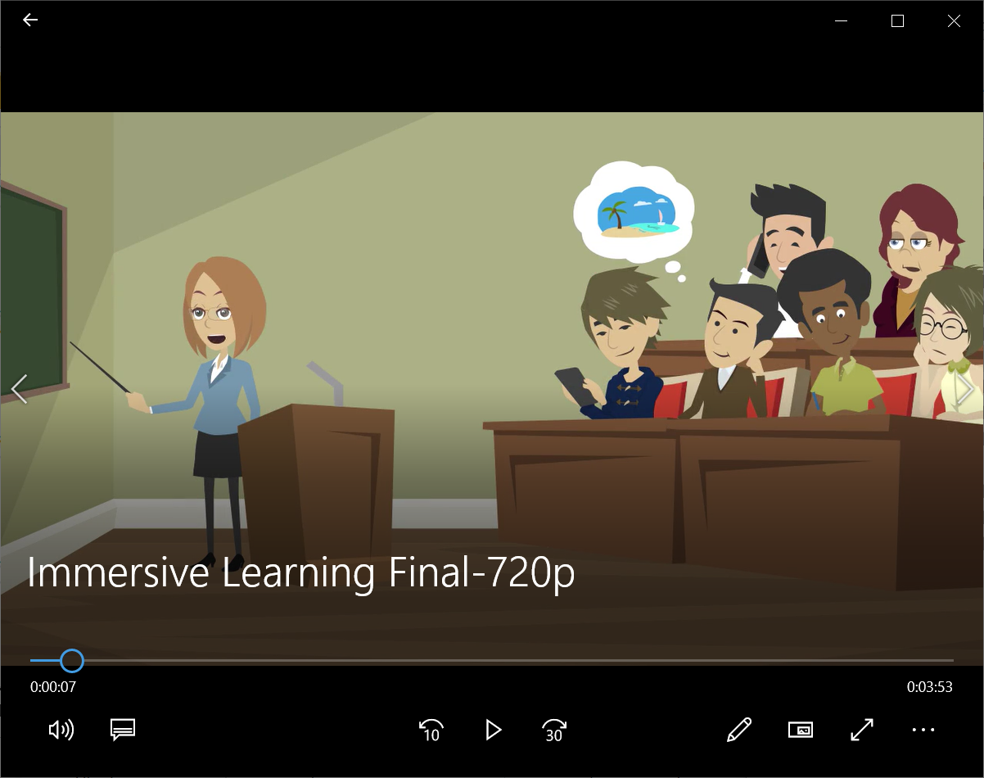
LDT 561
Projects
Notes:
Example of the final video

Slide 23
LDT 561: Advanced Multimedia Design
Application to Other Majors
Skills with various multimedia software such as GoAnimate and iMovie
Visual design and development
Abilities to work on real projects
Teamwork skills

Slide 24
A Side Effect for Undergrads...
Exposure to LDT grad students who are typically older, serious, and organized.
Similar to the cross-age one room schoolhouse.

Slide 25
Contact Us!
Dr. Wang - mwang@sdsu.edu
LDT General - ldt@sdsu.edu
Web - http://ldt.sdsu.edu
LDT Minor page: ​http://bit.ly/LDTMinor

